Slide 1
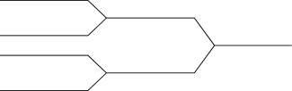


CSE 251
Electronic Devices and Circuits
Lecture 2
Prepared by: [AFI]

Slide 2
Lecture 2: KCL, KVL, Nodal Analysis & Line diagram

Slide 3



Alternative Circuit Representation: Line diagrams
Va
Goal: representing circuits using Shorthand notations
Steps
Identify the ‘Nodes’
Select one node as ‘Ground’
Replace the other known voltage nodes with an arrow
Vs= Va-Vb
Vb
Vs
R1
R1
R1
Vs
I
R2
Vs
I
R2
Vs
I
R2
I
R1
R2

Slide 4


Circuits with voltage sources of opposite polarities
I₁
I₃
I₁
I₃
5V
-10V
Va
Vb
R1
R3
R1
I₂
R2
5V
I₂
10V
I₁
I₃
Vo
5V
-10V
R1
R3
Vo= 0V [Ground]
For 5V : Va-Vo= (5-0) V => Va = 5V
For 10V : Vo-Vb= (0-10) V => Vb = -10 V
I₂
R2

Slide 5

Circuit with a current source/ floating voltage source: Keep them as they are!
5V
10V
R2
5V
10V
Floating voltage sources: None of the terminals of the voltage source is connected to the reference i.e. ground node

Slide 6
Kirchhoff's Current Law (KCL):
“The algebraic sum of all currents entering and exiting a node must equal zero.”
“Currents flowing into a node (or a junction) must be equal to the currents flowing out of it.”
I₁
I₃
R1
R3
I₁= I₂+I₃
1V
I₂
R2
2V

Slide 7
Kirchhoff's Current Law (KCL):
“The algebraic sum of all currents entering and exiting a node must equal zero.”
“Currents flowing into a node (or a junction) must be equal to the currents flowing out of it.”
I₁
I₃
1V
2V
R1
R3
I₁= I₂+I₃
I₂
R2
*This is also applicable to supernodes!

Slide 8
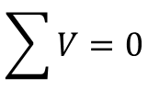

Kirchhoff’s Voltage Law (KVL): The algebraic sum of all voltages in a loop must equal zero
I₁
I₃
R3
R1
I₂
R2
5V
L1
10V
L2
Loop 1: 5-I₁R₁-I₂R₂ =0
Loop 2: 10+I₂R₂-I₃R₃ =0

Slide 9
I₁
I₃
+ V_{R1} -
I₂
+ V_{R3} -
5V
10V
+ V_{R2} -
Loop1
Loop2

Slide 10
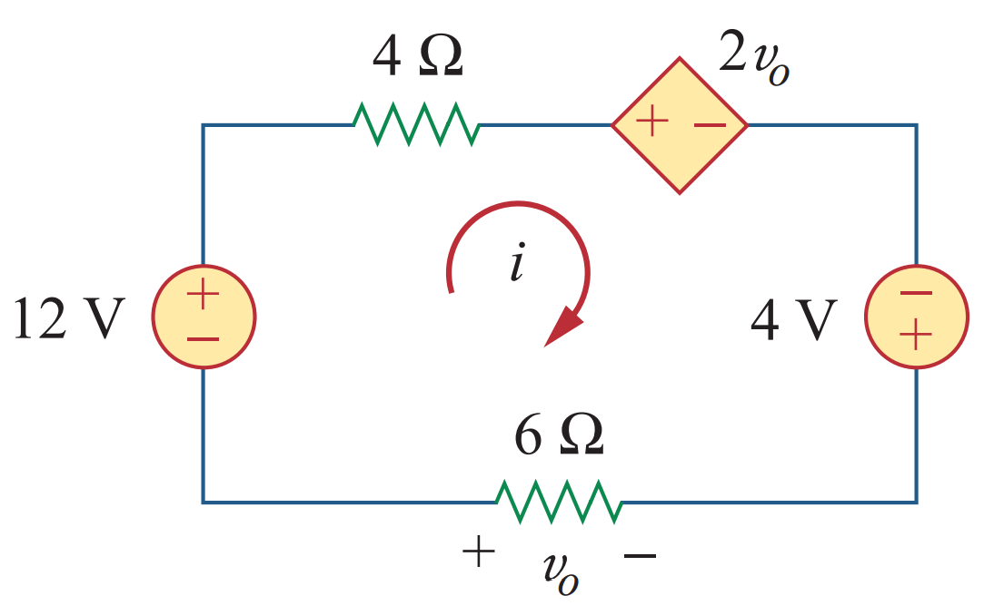
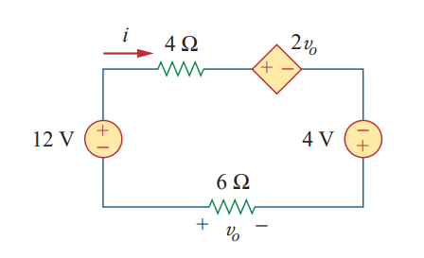

Slide 11
I₁
I₃
5V
-10V
R1
R3
Line 1: 5-0 =I₁R₁+I₂R₂ =0
Line 2: 0-(-10)=-I₂R₂+I₃R₃
L1
I₂
R2
L2

Slide 12
5V
10V
R2
Can you write a KVL equation along this line?

Slide 13
Nodal analysis:
I₁
I₃
Va
R1
I₂
R3
R2
5V
10V

Slide 14
I₁
I₃
Va
R1
I₂
R3
5V
R2
10V
Vo

Slide 15
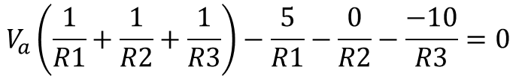
Nodal analysis:
I₁
I₃
5V
-10V
R1
R3
I₂
R2

Slide 16
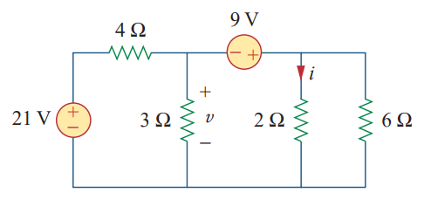
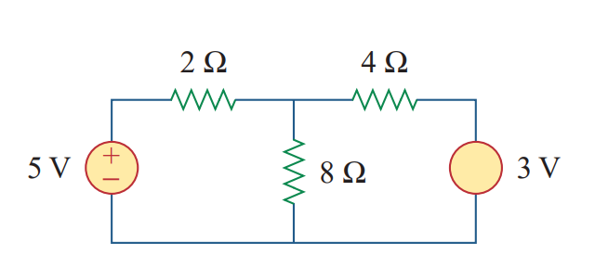
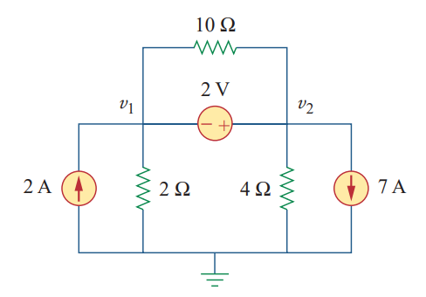
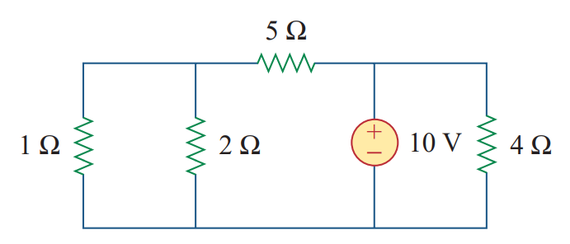
Practice Problems: i) Draw Alternative Circuit Diagrams , ii) Write down KCL equations, iii) Write down KVL equations and iv) Nodal equation

